Slide 1


Semantic Database Webinar
January 2023
Ver 2.0.2
Grant Steinfeld
https://github.com/Grant-Steinfeld

Slide 2

Data
Why I love it?
Notes:
Botanist
Fast
Inmotion
Lots of it

Slide 3
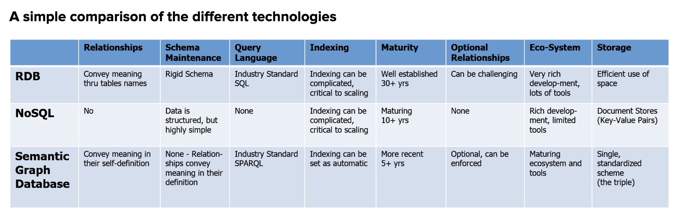
Comparison
RDBs ( MySQL, MSSQL, DB2 etc )
NoSQL ( CouchDB, MongoDB, DocumentDB, etc )
Semantic Graph DB ( Neo4j, allegroGraph(agraph) )

Slide 4
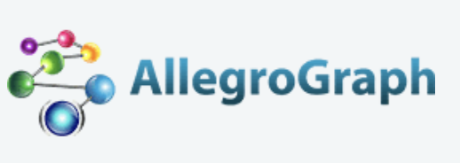
Overview
Unlike traditional relational databases or more recently developed NoSQL databases or simple property graphs,
Franz’s AllegroGraph employs a combination of semantic graph (RDF, OWL, SPARQL) and document (JSON, JSON-LD) technologies that process data with contextual and conceptual intelligence.
AllegroGraph with FedShard™ is able to run queries of unprecedented complexity to support predictive analytics that help companies make better, real-time decisions.
AllegroGraph is designed to integrate with large corporate databases to build Knowledge Graphs for better business insights.

Slide 5
Popular Use Cases
Social Networks - FOAF
Bio-Informatics
Music
Portfolio Analysis
Fraud detection – AML
…
Financial/Banking industry use cases
Notes:
Dodd-Frank Wall Street Reform
Mortgage and Loan rules and auditability of transactions
Credit Default Swaps ownership reporting
Know Your Customer requirements
Sarbanes-Oxley
Business and Legal Entity tracking requirements
Computation of derivatives risk
Basal III international regulations
Foreign corrupt Practices Act
UK Bribery Act
Fraud Detection
Personal Information security
New regulations on transfer pricing

Slide 6
3rd Party Integration
Cloudera
Anaconda
ML/Data mining
NoSQL Ecosystem
MongoDB integration
Solr Text indexing
Financial/Banking industry use cases
Notes:
Dodd-Frank Wall Street Reform
Mortgage and Loan rules and auditability of transactions
Credit Default Swaps ownership reporting
Know Your Customer requirements
Sarbanes-Oxley
Business and Legal Entity tracking requirements
Computation of derivatives risk
Basal III international regulations
Foreign corrupt Practices Act
UK Bribery Act
Fraud Detection
Personal Information security
New regulations on transfer pricing

Slide 7
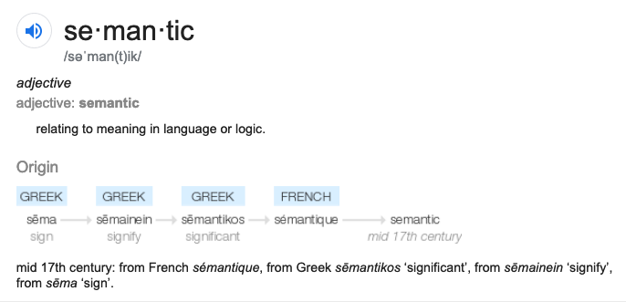
Semantic
MEANING | KNOWLEDGE

Slide 8
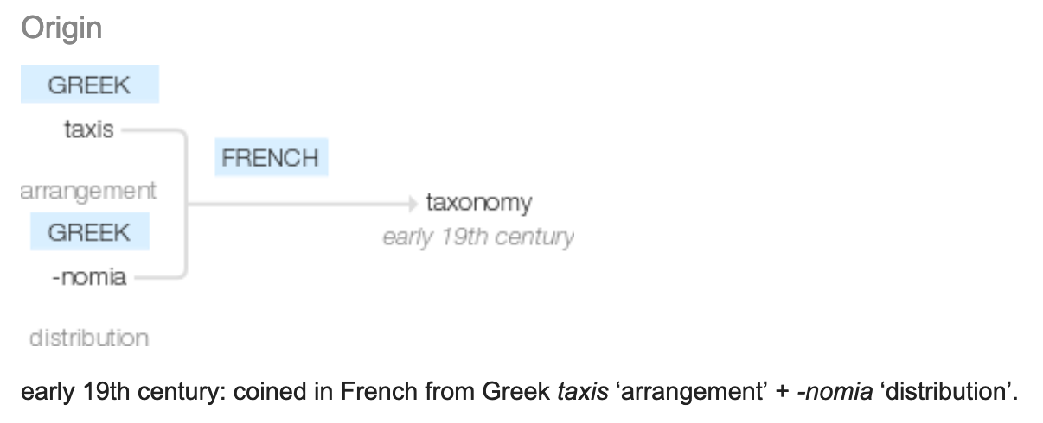
Taxonomy
Notes:
ONTOLOGY

Slide 9
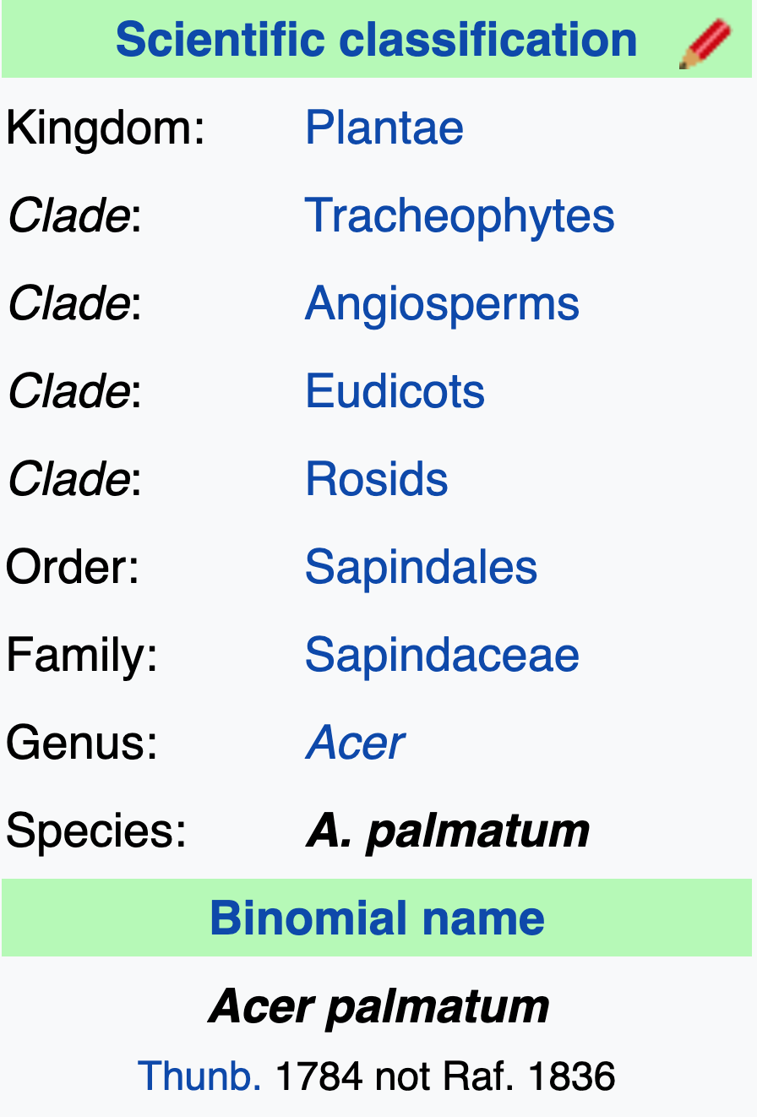

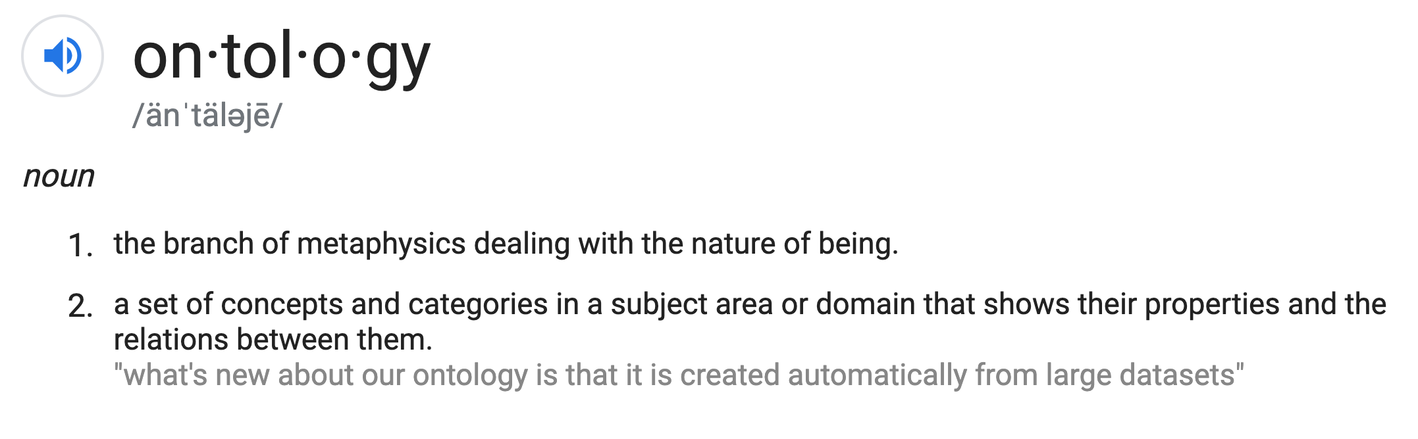
Ontology

Slide 10

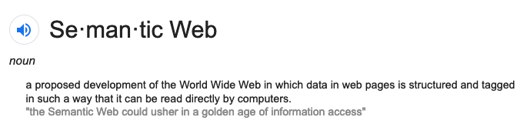
Golden age of Information Access

Slide 11
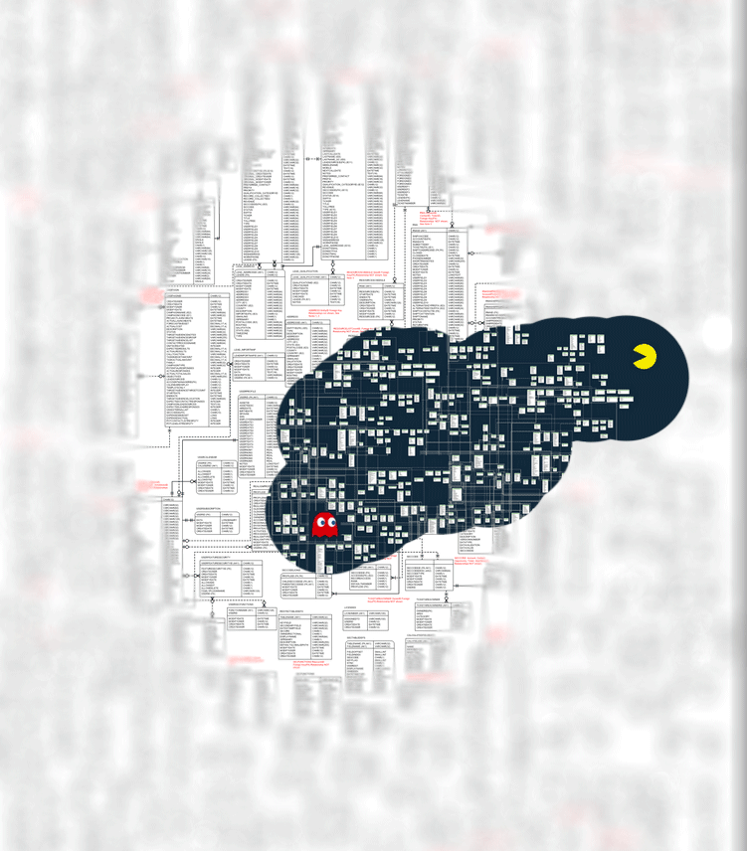
Inference New Ideas + Hypotheses Patterns
Notes:
LOOKING FOR
FINDING PATTERNS

Slide 12
Why?
Data
Volume huge
ETL
Retrieval / Query

Slide 13
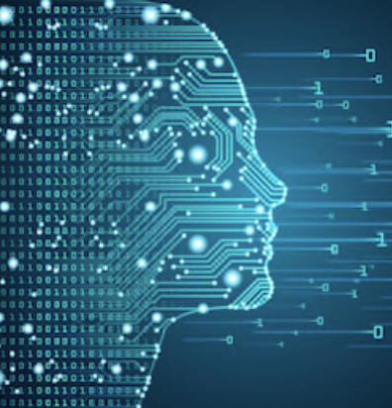
Web – worlds biggest `sensor`
Web pages – Human readable – unstructured
What is machine readable? – structured
Big Fast Moving Data – overwhelming TL;DR;
Notes:
How to Derive Structure from Unstructured Web
Google search – good for humans

Slide 14
RDF – sums it up
Resource Description Framework
RDF is a standard model for data interchange on the Web
.
RDF has features that facilitate data merging even if the underlying schemas differ.
Specifically supports the evolution of schemas over time, without requiring all
the data consumers to be changed.

Slide 15
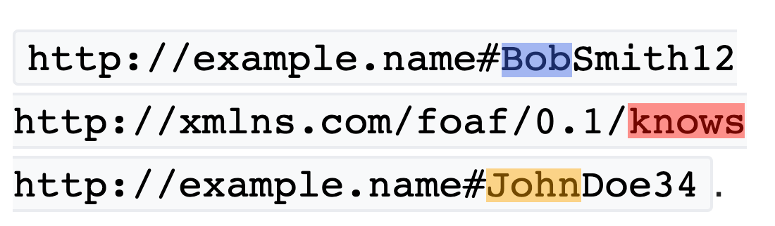
RDF Triples
SUBJECT
PREDICATE
OBJECT
Notes:
RDF extends the linking structure of the Web to use URIs to name the relationship between things as well as the two ends of the link

Slide 16
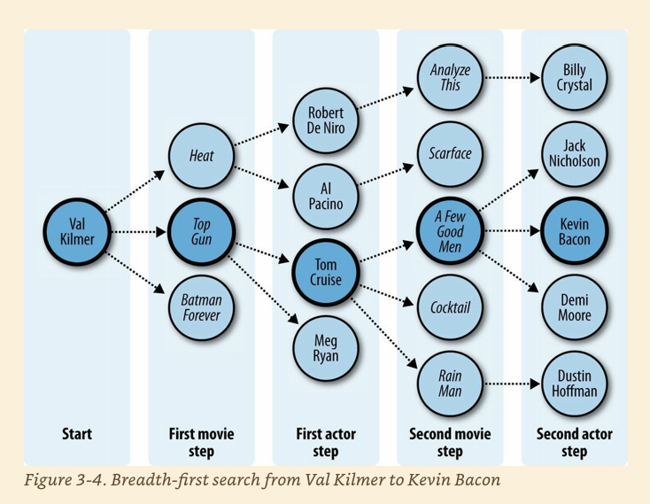
FOAF Six degrees of seperation
Notes:
﻿Six Degrees of Kevin Bacon A good example of the breadth-first search algorithm is the trivia game “Six Degrees of Kevin Bacon,” where one player names a film actor, and the other player tries to connect that actor to the actor Kevin Bacon through the shortest path of movies and co-stars. For instance, one answer for the actor Val Kilmer would be that Val Kilmer starred in Top Gun with Tom Cruise, and Tom Cruise starred in A Few Good Men with Kevin Bacon, giving a path of length 2 because two movies had to be traversed.
Evans, Colin. Programming the Semantic Web: Build Flexible Applications with Graph Data (p. 51). O'Reilly Media. Kindle Edition.

Slide 17
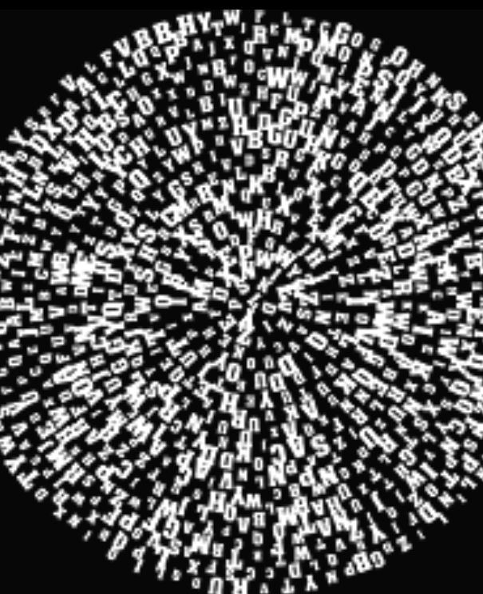
Triple `Soups`
Bowl -> Triple Store – Semantic Graph DB
`Alphabet soup` -> SPO OPS POS SOP POS
Merge ?
Notes:
Merge Using this simple model, it allows structured and semi-structured data to be mixed, exposed, and shared across different applications.

Slide 18
Flavors
N-Triples
RDF
aRDF

Slide 19
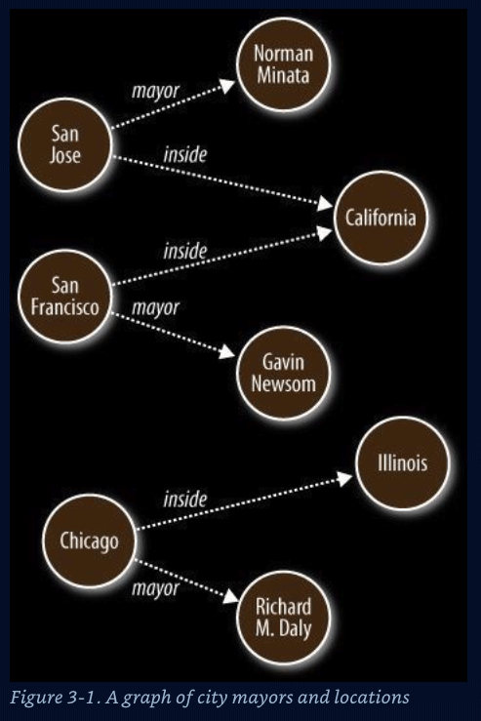
Graph
Nodes – Data Entities ( nouns )
S O
Edges – Relationships ( verbs )
P
Graph algorithms
Reasoning ( Decisions )
Inferences
Shortest path
Cliques / Neighborliness
Interconnected ness
Patterns
Notes:
Represent data that is hard to store in columnar and row format

Slide 20
Use cases for semantic / graph
Social Networks - FOAF
Bio-Informatics
Music
Portfolio Analysis
Fraud detection – AML
Notes:
AML anti money laudering – human trafficking, illegal arms dealers,

Slide 21
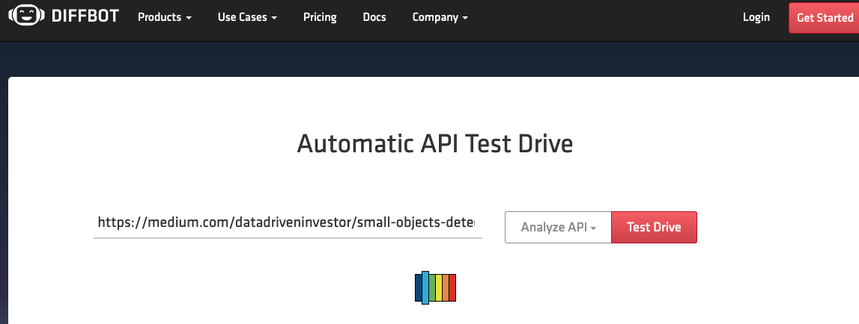
Extraction – demo 1

Slide 22
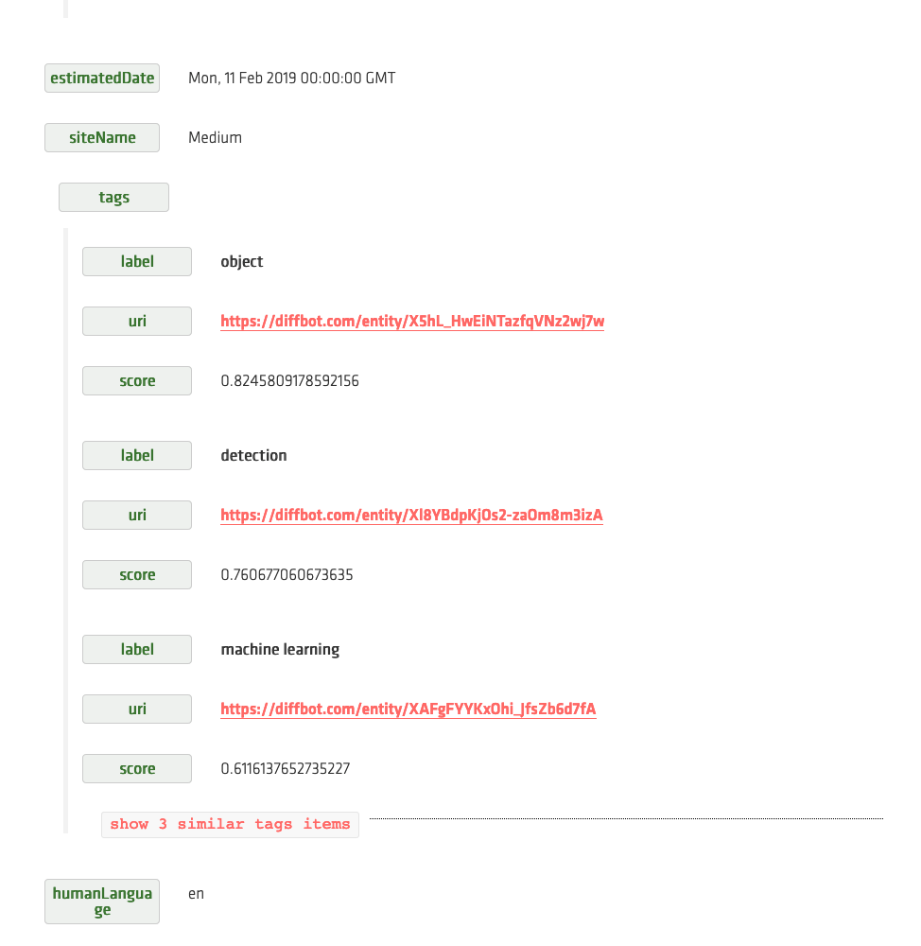
Extraction

Slide 23
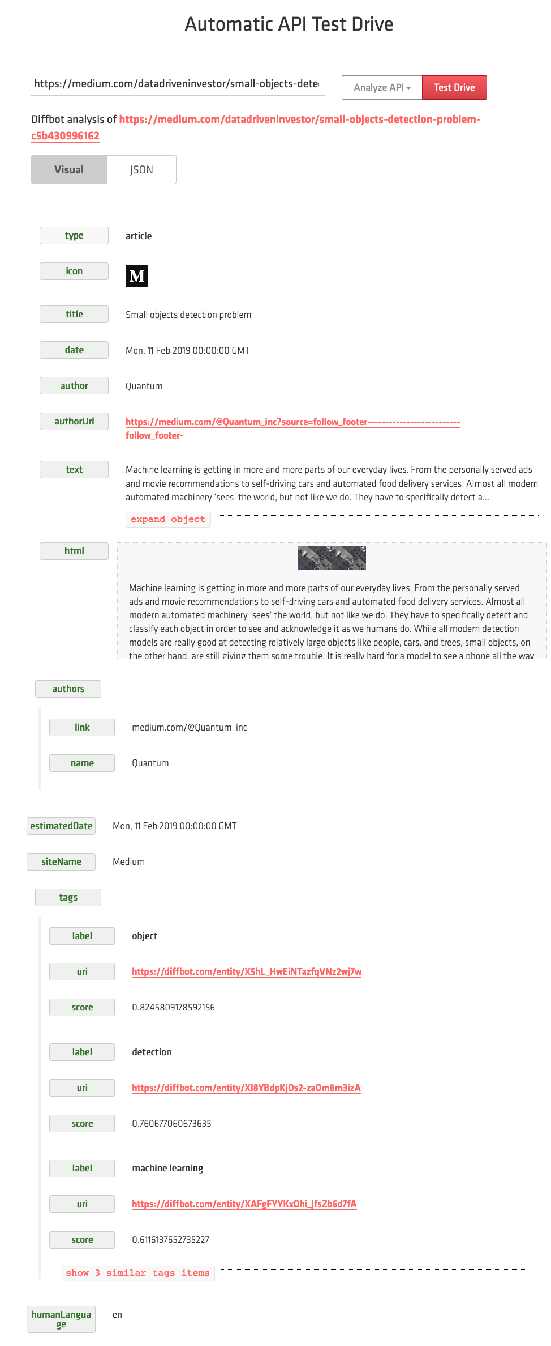

Slide 24
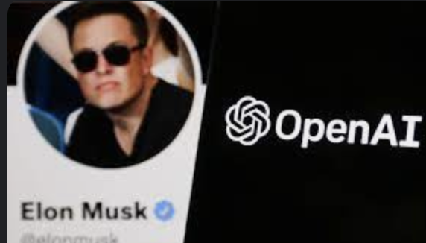
Popular Semantic/Graph databases
AllegroGraph RDF store (SAAS AWS, Linux Virtual Machine on Azure )
Neo4j ( AWS Marketplace, SAAS Azure )
Azure Cosmos DB for Apache Gremlin on Azure
Amazon Neptune on AWS
Serverless graph database designed for superior scalability and availability
Check out the Popular Graph DBs
Get-GPT3Completion "top 6 graph databases"
1. Neo4j
2. Amazon Neptune
3. OrientDB
4. ArangoDB
5. FlockDB
6. AllegroGraph

Slide 25
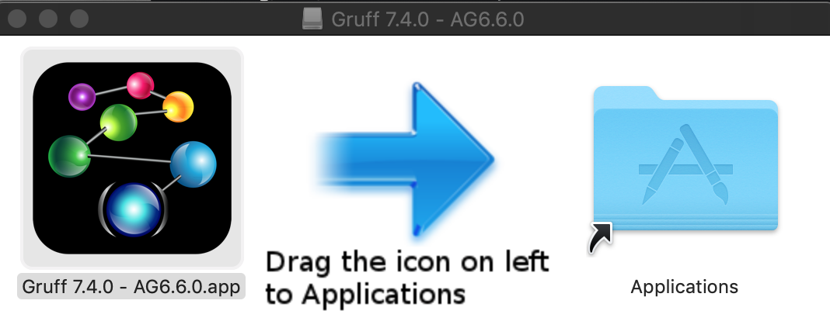
Demo Gruff
Notes:
Show pizza in Web View - Add Triples … then display sample nodes

Slide 26
Docker version of Agraph https://franz.com/agraph/docker/

Slide 27

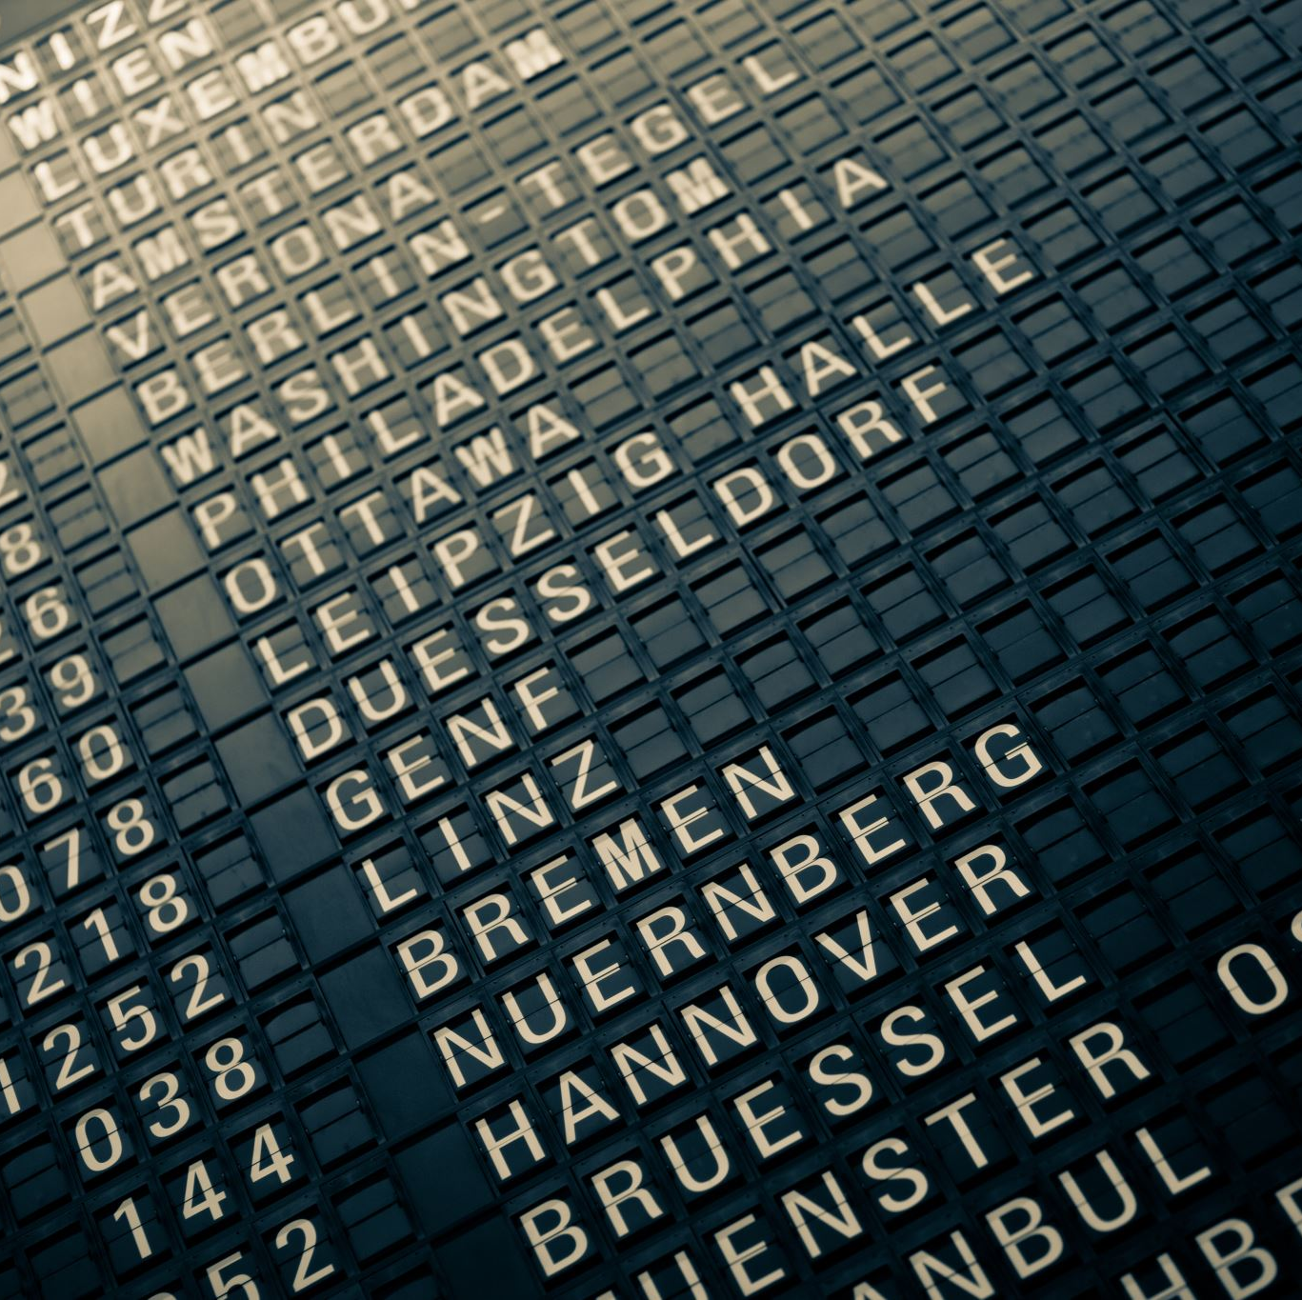

Thank you!!
https://github.com/Grant-Steinfeld/
@gsteinfeld

Slide 28
Resources
Evans, Colin. Programming the Semantic Web: Build Flexible Applications with Graph Data ( book on Amazon )
AllegroGraph (agraph) DB homepage, Franz Inc. https://franz.com/
﻿N-TRIPLES spec - http://www.w3.org/TR/rdf-testcases/#ntriples.
Blog - Ontology and Data Science - Favio Vaquez

Slide 29
Resources (2)
Semantic Graphs: What they are and Why You Should Care ( Blog by David Vandegrift )
Dbpedia Global and Unified Access to Knowledge Graphs ( core engine Wikipedia )
Wikimedia / Commons
Schema.org – discover common and standard labels (Predicates (P))
Ontology Completion with Graph-Based Machine Learning: A Comprehensive Evaluation (Journal article, December 2022 by Sebastian Mežnar and others )
Semantic similarity and machine learning with ontologies ( Journal article 13 October 2020 by Maxat Kulmanov, Fatima Zohra Smaili, Xin Gao, Robert Hoehndorf)
Briefings in Bioinformatics, Volume 22, Issue 4, July 2021, bbaa199, https://doi.org/10.1093/bib/bbaa199

Slide 31
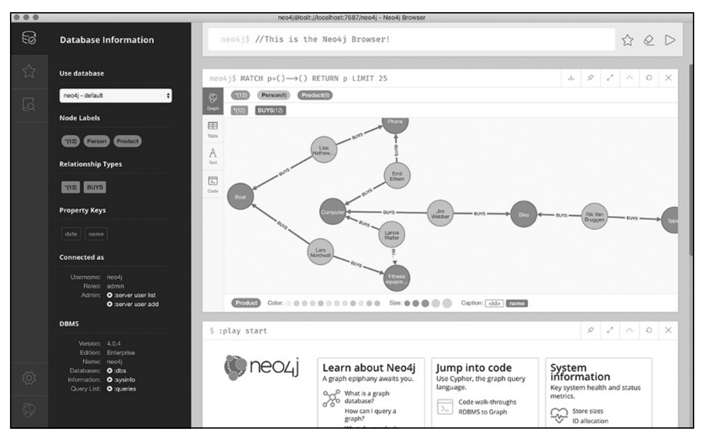
Neo4j
The web based ‘browser`

